Slide 1
PIZZA SALES DATA ANALYSIS – BUSINESS SUMMARY by
AFOLAYAN OREOFEOLUWA
10th of February, 2026

Slide 2
OUTLINE
Data set overview
Overall business performance: key performance indicators (KPIs)
Peak ordering time
Sales by pizza category
Revenue by pizza category
Top selling pizzas
Order by day, month and quarter order trends
Sales by pizza size
Key business findings
Business recommendations
2

Slide 3
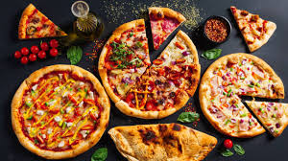
DATASET OVERVIEW
Sales transaction data from a pizza shop
Covers customer orders across different time periods
Key data fields include:
order time and date
pizza category and size
quantity sold
revenue generated
strategies for growth

Slide 4



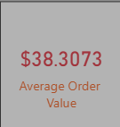
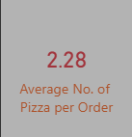
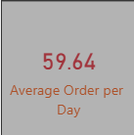
OVERALL BUSINESS PERFORMANCE: KEY PERFORMANCE INDICATORS (KPIS)
Total revenue: $817.86k
Total orders: 21K
Total pizzas sold: 49K
Average order value: $38.31
Average pizzas per order: 2
Average order per day: 60
Insight:
The business shows strong overall sales volume with customers ordering multiple pizzas per transaction.
4

Slide 5
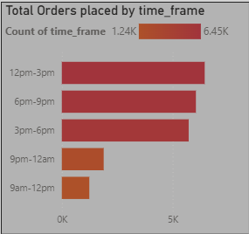
PEAK ORDERING TIME
Customer ordering patterns by time
Peak ordering period is 12pm – 3pm
Evening hours (6pm – 9pm) also show high demand
Lowest orders occur during morning hours
Insight:
Sales are concentrated around lunch and evening periods.

Slide 6
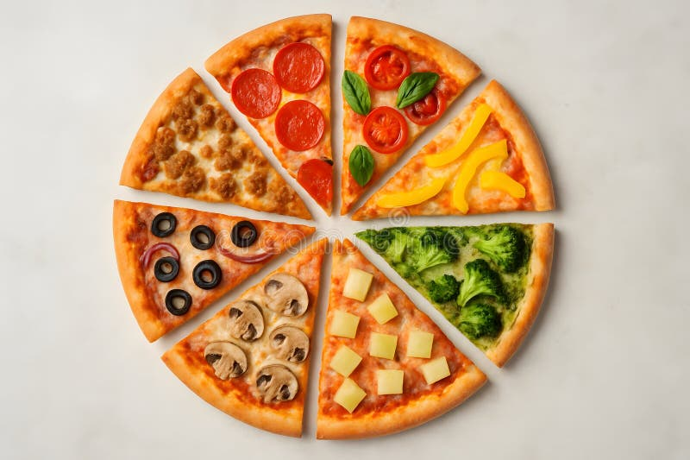
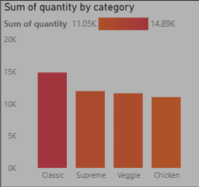
SALES BY PIZZA CATEGORY
Quantity sold per category
Classic pizzas have the highest quantity sold
Followed by supreme and veggie
Chicken pizzas record the lowest quantity sold

Slide 7
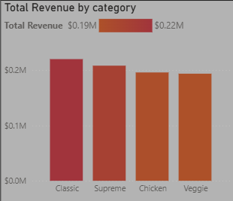
REVENUE BY PIZZA CATEGORY
Revenue Contribution
Classic category generates the highest revenue
Supreme and Veggie categories closely follow
Veggie pizzas are the most expensive pizza type
Insight:
High pricing does not always translate to highest sales volume.

Slide 8
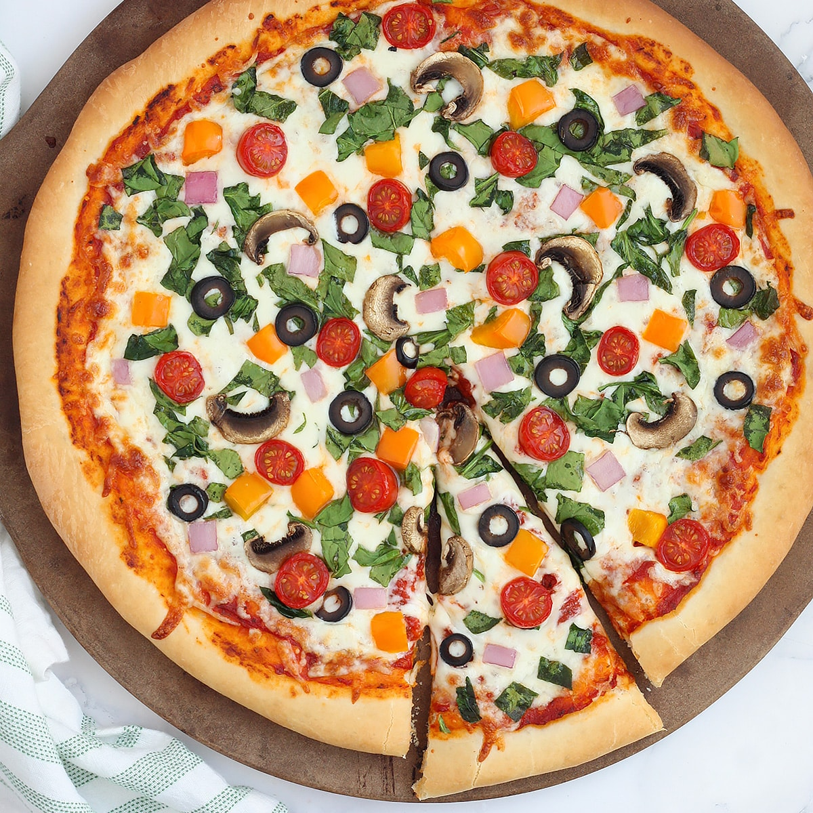
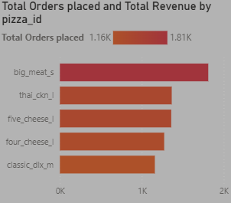
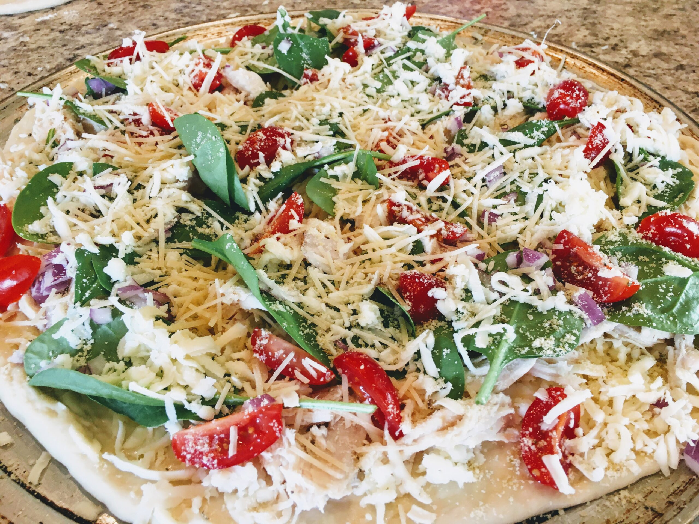
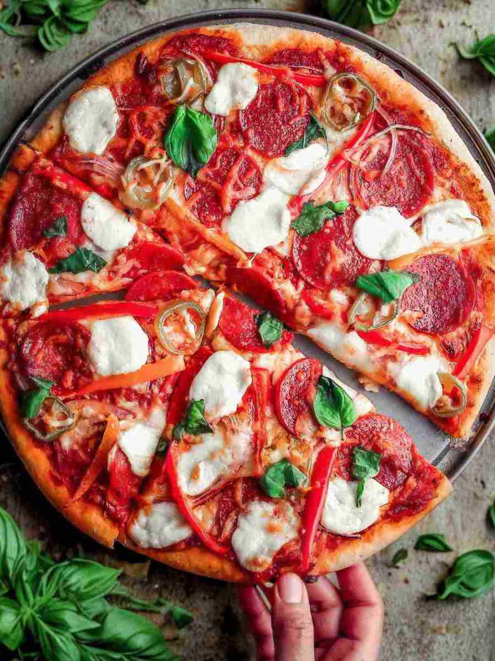
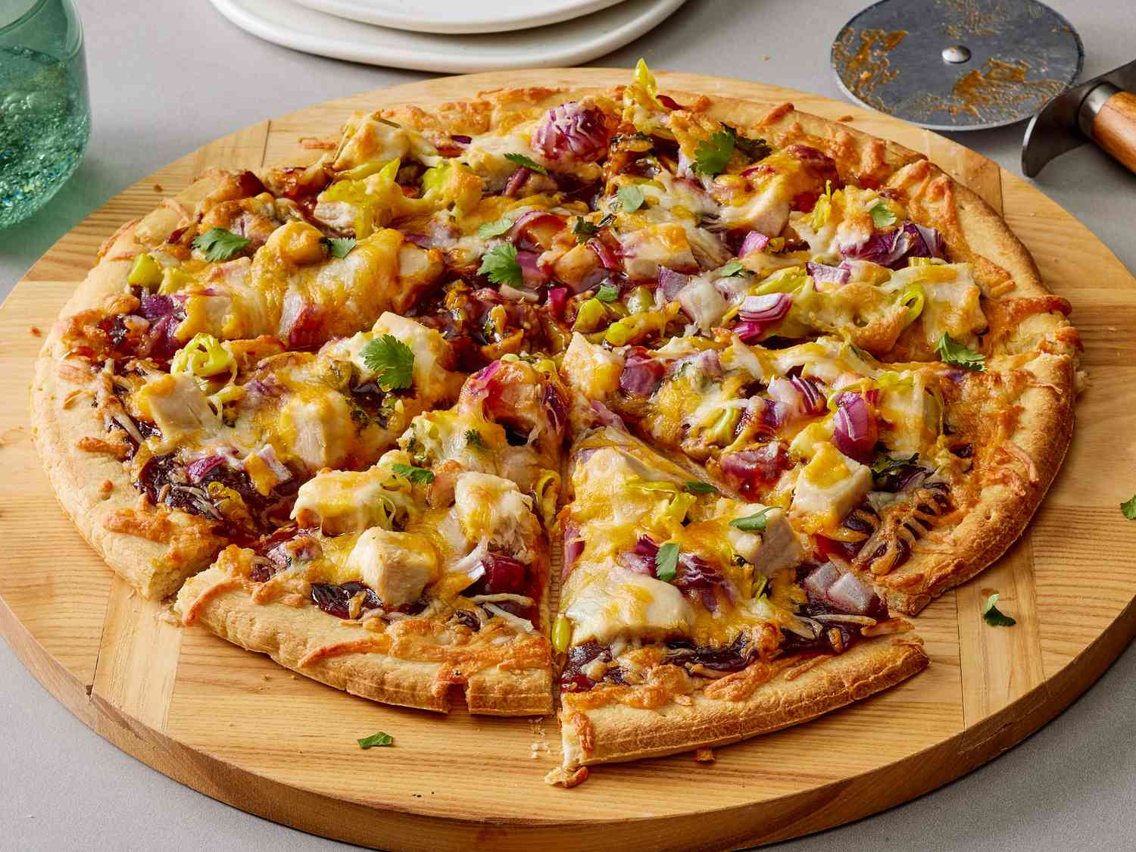
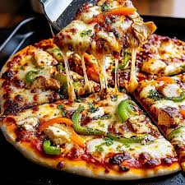
TOP-SELLING PIZZAS
Top 5 Pizzas by Number of Orders
Big Meat (S)
Thai Chicken (L)
Five Cheese (L)
Four Cheese (L)
Classic Deluxe (M)
Insight:
Customer demand is concentrated on a small number of menu items.

Slide 9
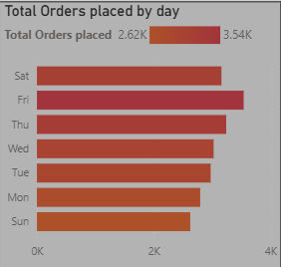
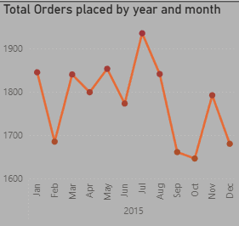
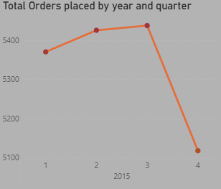
ORDERS BY DAY, MONTH & QUARTER ORDER TRENDS
Fridays and Saturdays record the highest orders
Monthly sales fluctuate with noticeable peaks mid-year
Quarter 3 shows the highest order volume
Insight:
Sales patterns suggest opportunities for targeted promotions during low-demand periods.
9

Slide 10
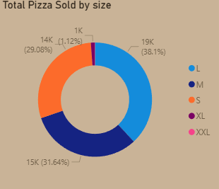
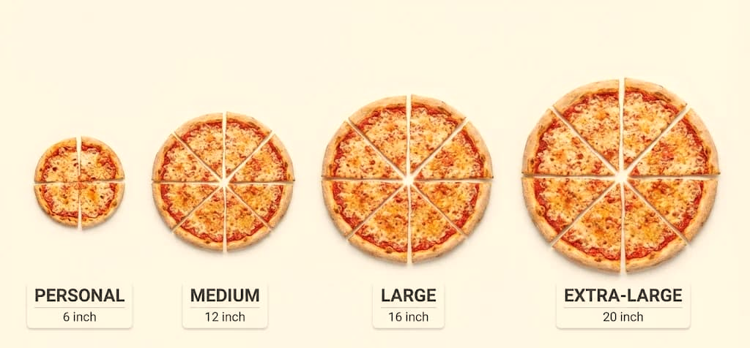
SALES BY PIZZA SIZE
Customer Size Preference
Large (L) pizzas generate the highest sales
Medium (M) and Small (S) sizes follow
Extra-large sizes contribute minimally
Insight:
Customers strongly prefer larger pizza sizes.

Slide 11
KEY BUSINESS FINDINGS
Summary of Insights
Sales peak between 12pm – 3pm
Classic pizzas dominate both revenue and quantity sold
A few pizzas account for most orders
Veggie pizzas are priced highest but not top-selling
Larger pizza sizes are most preferred by customers

Slide 12
Business Recommendations
Recommended Actions
Focus promotions on top-selling pizzas (Big Meat, Thai Chicken, Cheese varieties) as they generate most orders.
Optimize staffing and pizza preparation during peak hours (12pm–3pm) to improve service efficiency.
Promote Large-sized pizzas, which are the most preferred and generate the highest sales.
Review and adjust the pricing strategy for Veggie pizzas, which are the most expensive but not top-selling.
Reduce menu complexity by reviewing or reworking low-performing pizzas to cut costs and waste.
Introduce weekday and off-peak promotions to boost sales during slower periods.

Slide 13
thank you
Afolayan oreofeoluwa
+234 816 525 2977
  elsieagnes804@gmail.com

